Slide 1
Quantification of tumor fluorescence during intraoperative optical cancer imaging
Presenter: Macan Tadayon

Slide 2
Imaging can be beneficial to Cancer patients
Imaging can help in screening for cancer
Imaging can help in diagnosis/staging
Imaging can help in guiding cancer treatments

Slide 3
Evaluation Criteria for comparing different Techniques:
The detection of small changes in fluorescence considered as the first important criteria
Sensitivity of signal detection at increasing depths considered as the second important criteria
Practicality of use considered as the third important criteria.

Slide 4
Common methods of intraoperative optical cancer imaging
Spectroscopy is based on optical fibers.
Luminometry is based on singlet–singlet electronic relaxation.
digital imaging is based on intensified charge-coupled devices

Slide 5
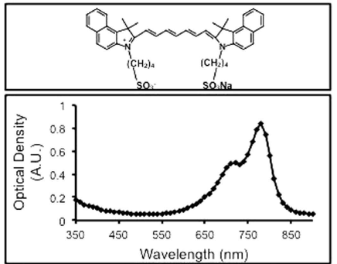
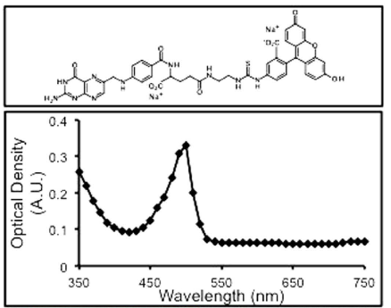
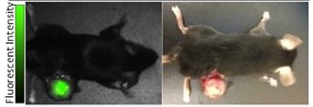
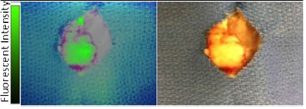
Materials used to choose the best method

Slide 6
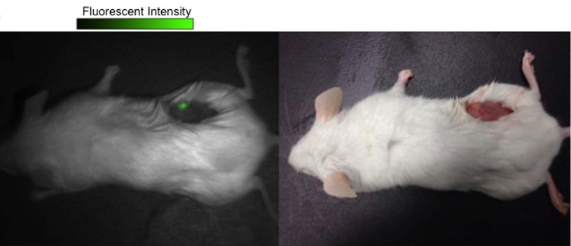
Residual fluorescent tumor detected in the surgical bed by fluorescence imaging

Slide 7
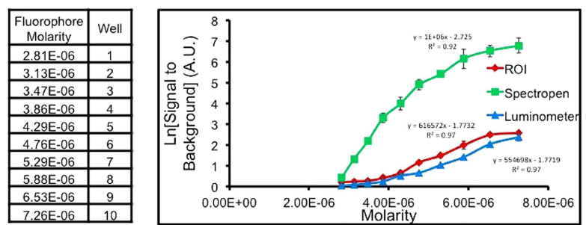
Serial dilution concentrations of ICG and SBR vs ICG concentration.

Slide 8
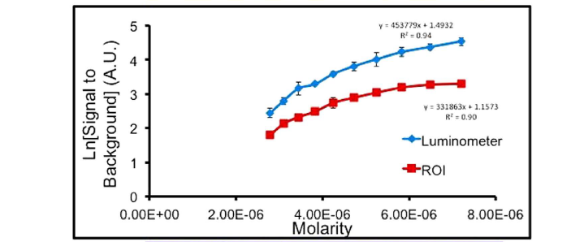
SBR vs. EC-17 concentrations

Slide 9
Models used to compare the different techniques
The first model used in the experiment was Vitro Phantom model
The second model used for the comparison was Murine Flank Tumor Model

Slide 10
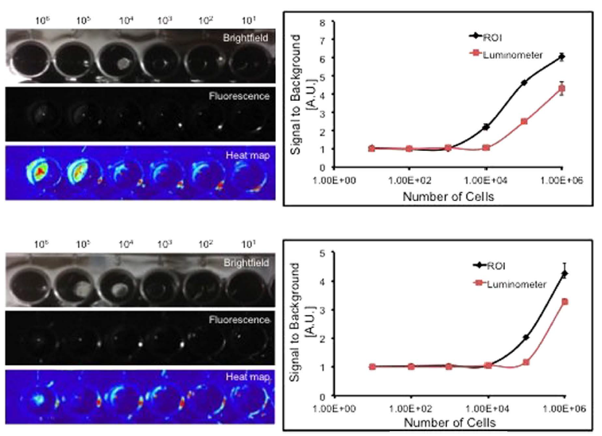
Comparison of imaging techniques in vitro

Slide 11
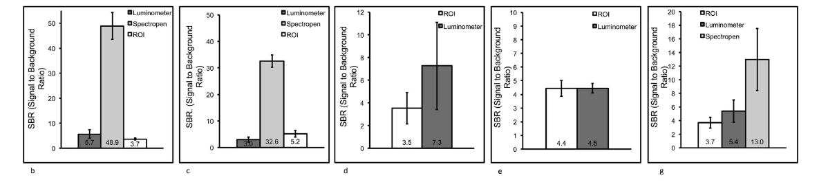
Quantification of tumor fluorescence in murine models

Slide 12
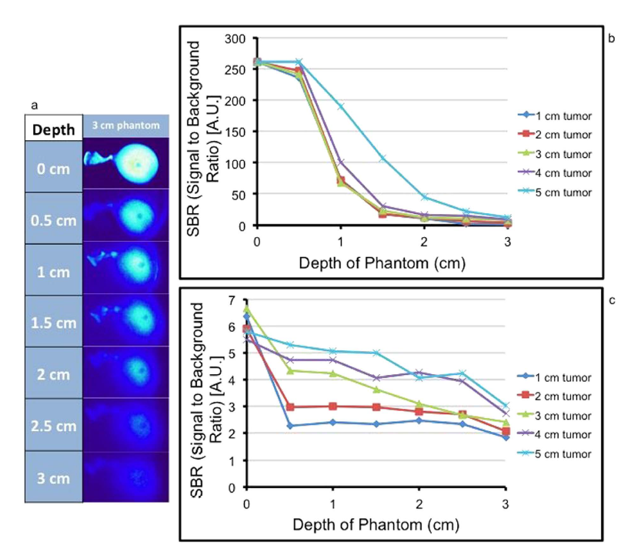
Signal Detection as a function of depth

Slide 13
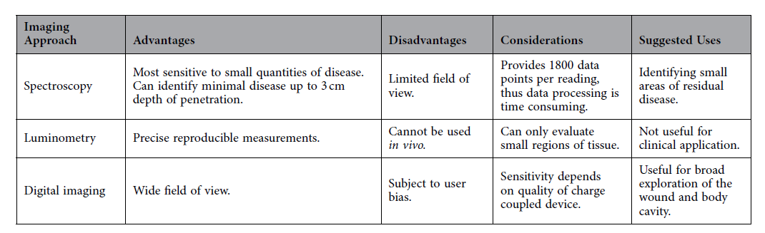
Imaging modality comparison

Slide 14
Thank You

